Slide 1
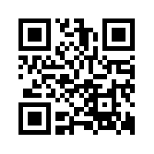
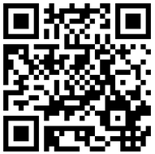
Creating Videos and Animations to Enhance Organic Chemistry Lecture and Laboratory Instruction
Dr. Laurie S. Starkey
Chemistry & Biochemistry Dept. Cal Poly Pomona
lsstarkey@cpp.edu
255th ACS National Meeting
New Orleans, 3/22/18
QR Code for my homepage
Teaching & learning resources

Slide 2
Why use videos/animations as supplements?
Better than a book (if a picture is worth 1,000 words…)
Better than a lecture?
Asynchronous learning – 24/7 access
Asynchronous teaching – not confined to 50 minutes
Students are able to pause, repeat, read captions, take notes
Global: bring in new instructors/reach a wider audience
For “flipping” the classroom
Enables in-class problem solving, active learning
Introductory and/or boring material (IUPAC, hybridization)
Narrated answer keys, homework solutions (3D Sketch)
Material that is likely to be reviewed later (Reagent Table)

Slide 3
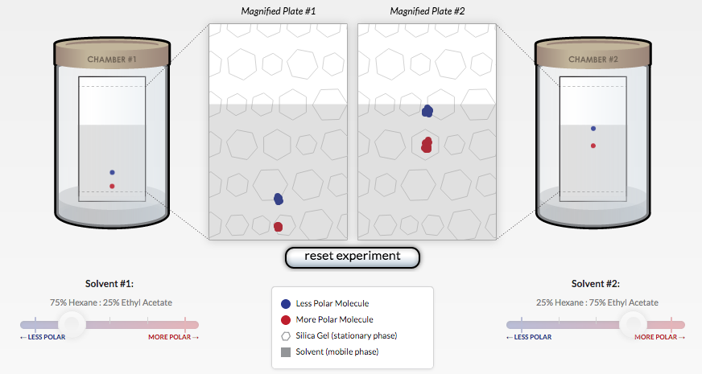
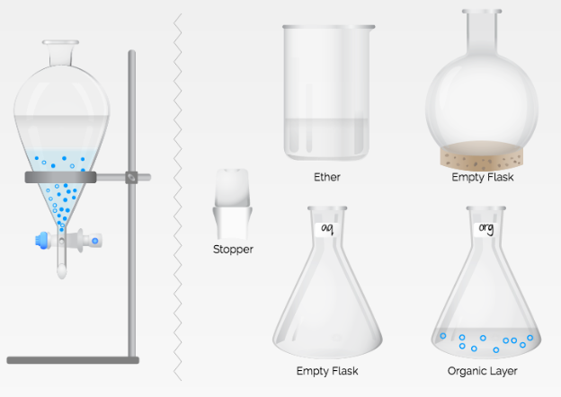
Technology for Lab Preparation
Online Quizzes (Blackboard): 27/7, instant feedback, formative assessment
Animations (with worksheet) TLC | Extraction

Slide 4
Online Tutorials for Lab Preparation
Adobe Presenter (PowerPoint plug-in)
narrated, Pp animations
embed Flash/HTML5
filming of demos

Slide 5
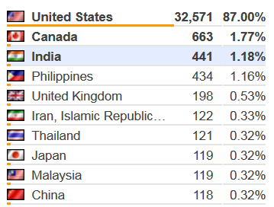
Online Tutorials for Lab Preparation
http://www.cpp.edu/~lsstarkey/ochemlab
over 37,500 worldwide visitors to website since 2008
Benefits: unlimited time, asynchronous, reviewable, available in the future (website/YouTube vs. LMS)

Slide 6
Assessment of Technology Prelab Quiz: Sketch Distillation Apparatus
Percent of Students at each Score (Max Score = 10 points)

Slide 7
Assessment of Technology Prelab Survey: Confidence in Running Distillation Experiment
Mean = 5.0
Mean = 7.6

Slide 8
Tech-Assisted Lab Preparation: Student comment
“I have never before taken a lab course at this university where so much help was provided for preparing for the lab. Between the Blackboard quizzes and online tutorials I always felt I had enough preparation for the lab, and this helped me perform better and understand the actual experiment.” CHM 317L, Fall 2012

Slide 9
Making videos for the flipped classroom & beyond
Online lectures – search YouTube, Educator.com, EdX
Create your own! “Old school-style” recording of narrated homework solutions (iPhone) 3D sketch reagent table
Latest technology: transparent lightboard! (how it works)
Record and edit videos with Camtasia (screen capture/voice) Tutorials: http://tiny.cc/CreatingPedagogicalVideos Examples: Engineering tutorial and solved problem
Lecture-capture w/iPad apps - can export videos to YouTube Explain Everything Cyclohexane and Doceri Reagent Table

Slide 10
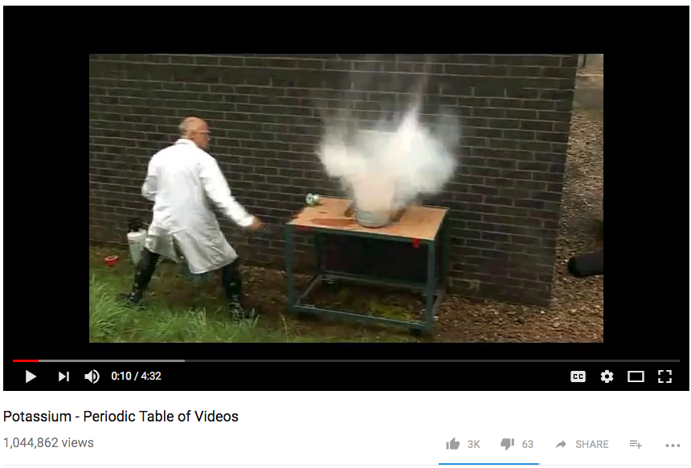
Don’t Reinvent the Wheel!
YouTube demos, simulations, animations CHM 315 - free, no hazards, can pause/watch later, etc. - find resources: PhET, MERLOT.org, LOCAL

Slide 11
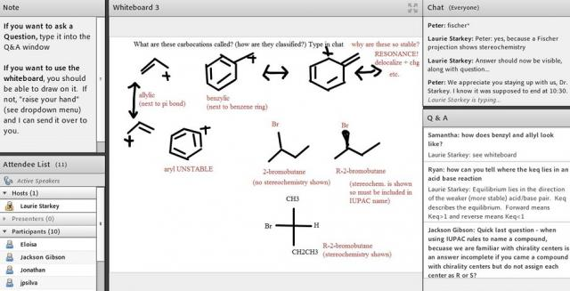
Tech-Enabled Communication
Virtual office hours (Adobe Connect)
the night before each exam, 9:30-10:30 pm
can record sessions
Chat, Q/A
supervised peer- to-peer learning

Slide 12
Sharing your work
Private (LMS) or Public (webpage link, MERLOT)
Include captioning for accessibility (Hablas Español? Si!)
Maximum exposure: make a YouTube channel!
ChemistryConnected, created in 2012, has over 480,000 views and over 970 subscribers
Pre-lab tutorials, solved problems, demos of hands-on elementary school science activities
Over half the views have come from outside the U.S. (200 different countries)
http://www.youtube.com/user/ChemistryConnected

Slide 13
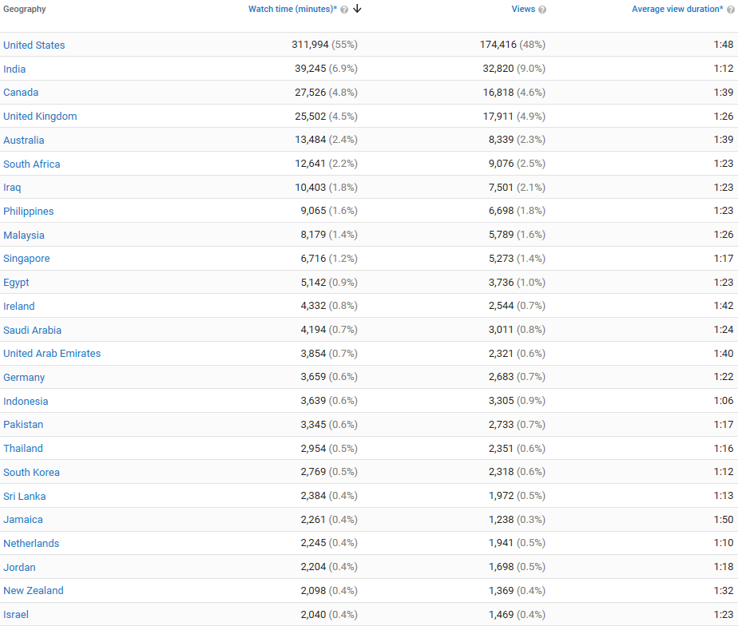
Chemistry Connected YouTube Channel

Slide 14
Making it Academic – SoTL Research
Turn your innovation into a research project!
Formulate a question
Collect data (can be a great “wow” factor)
Get IRB approval (Human Subjects)
Pre- vs. Post-Intervention
Quantitative and Qualitative data
Perform assessment; analyze data
Share results with colleagues and the world!
Conference paper, Ed. Journal article, RTP

Slide 15
Getting Buy-In and Support from Students, Faculty, Institution
Poorly implemented interventions unlikely to succeed
If you are enthusiastic, students are likely to be too
Explain WHY you do what you do – pedagogy matters!
Share data and testimonials and data with colleagues – encourage a SoTL-supportive culture
Institutional $upport: workshops, summer institutes, release time, mini-grants, free iPads (!), Faculty Learning Communities (clicker, SoTL, technology)
Collaborate with research students, other institutions…

Slide 16
Support & Acknowledgments
CPP Faculty Center for Professional Development Investigating Teaching & Learning Fellowship, Connecting Learning & Technology FLC, Clicker FLC, countless workshops Dr. Victoria Bhavsar, Dr. Peggy Perry, Dr. Carol Holder
CPP eLearning, CPP Mediavision Animations, Lightboard,Video production & Wall of COOL
Terry Hogan, April Dawn
Bo Choi, Tommy Gaston, Erick Zelaya
CSU Course Redesign with Technology Grants x3 CPP SPICE Grants x2 CSUPERB Grant (CSU Biotech. Ed & Research)

